Slide 1
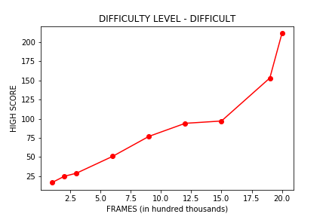
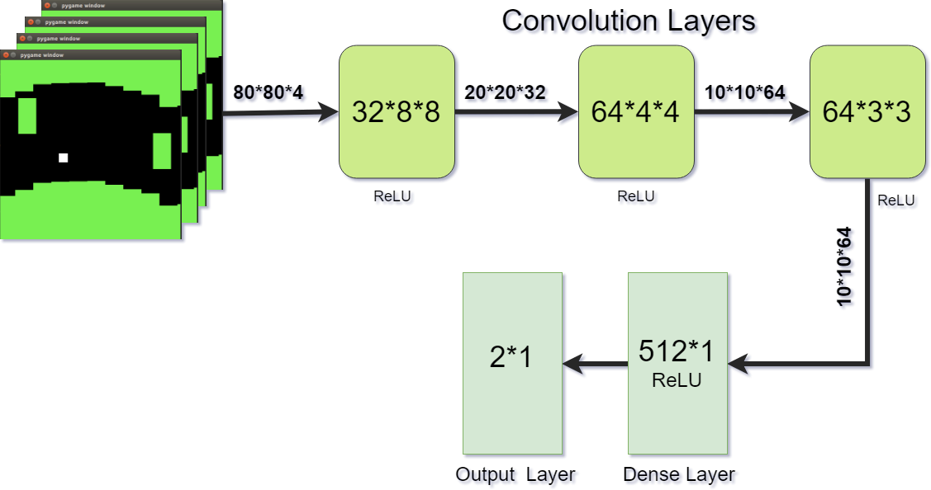
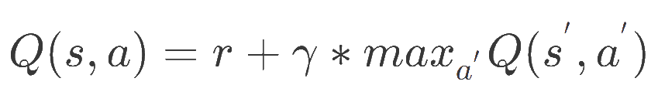
Copter Bot based on Deep Q-Learning
Harivignesh Rajaram – Pranav Kumar Sivakumar – Saikrishna Jaliparthy
CSCI 5622 Machine Learning
Background
Methods
Methods
Results
Game bots are a popular means of exploring the application of Reinforcement learning. The paradigm of learning by trial-and-error, solely from rewards or punishments, is known as reinforcement learning (RL). With the inclusion of Deep learning concepts, the performance of automated game playing programs has seen much advancement that can go beyond the ability of even expert level human players.
Copter is an interesting classic game to work on with Reinforcement Learning since it doesn’t have a final goal state to achieve, rather only the high score from staying alive for longer time/distances(which is calculated as the score for the game).
Preprocessing: Game environment is generated with the help of python pygame and Python Learning Environment . After getting the image frames from the environment, to fasten the training process, images are converted into a grayscale image followed by reshaping it down to 80x80 pixels. Then consecutive four frames are stacked together and fed into the neural network.
The action is either pressing the key or not. We reward the agent for each successful move and punish it when it collides the border or an obstacle. With every game played, the bot observes the previous states and its actions. Over the outcomes, it punishes or rewards the state-action pairs.
Q-learning is primarily represented by the Q-function, Q(s,a) which denotes the maximum discounted future reward when we perform action a in state s. It also indicates how good that action is. Suppose you are in state s and not sure which action to choose (a or b), then take the one which has the maximum Q-value obtained from the Q-function.
The Q-function is defined as,
In plain English, it means maximum future reward for this state and action (s,a) is the immediate reward r plus maximum discounted future reward for the next state s​′​, action a​′ (with gamma as the discount factor). ​​The idea behind the Deep Q-learning is that we compress the Q-table(with all the Q-values) using the neural network and represent the Q-function using the weights. The output from our Convolutional Neural network are the Q-values of each possible actions.
Experience Replay:
During the gameplay all the episode (s, a, r, s’) are stored in replay memory D. When training the network, random mini-batches from the replay memory are used instead of most the recent transition, which will greatly improve the stability.
Conventional Training(laptops) is not enough for developing this type of model. So we opted for using on-demand cloud computing services, AWS. We trained our model in an instance(p3.2xlarge) that has a NVIDIA Tesla V100 GPU (16GB), for 16 hours on about 2 million frames.
Based on the obstacle size , agent velocity, etc, the version of our game is considered hard. The above graph illustrates the increasing high-scores of the bot with the increase in the number of iterations during training in the difficult version. For the initial 1 million frames the exploration co-efficient is gradually decreased. The weights stored are updated for every 1000 frames.
We observed that as the training frame count increases the model learns to achieve higher average scores. We have developed an efficient Copter bot using a Deep Q-Learning based CNN model.
Figure 2. Scores vs Frames
Figure 1. Model Architecture
In our CNN architecture, the first convolutional layers gets the input image stack and 32 8x8 filters are applied on it. This is followed by another convolutional layer which applies 64 4x4 filters on it. This is tailed by another convolutional layer which applies 64 3x3 filters. All three convolutional layers have ReLU activations. This is followed by a dense layer with 512 rectifier units. And the final output layer is a dense layer whose dimensions are equal to the number of valid actions in the game. In our case its two valid actions.
Q-Learning:
A reinforcement learning algorithm called Q-Learning is utilized as it has been proven that for any finite MDP, at a given state Q-learning can find an optimal policy such that the reward is maximum by taking into account the successive states. For our problem, the state is the current position of the copter and the obstacles.
Objectives
Our objective is to develop a Deep Neural Network model to automate an agent to play the PixelCopter game.
The Copter is a classic side-scrolling game where the agent must successfully navigate through a cavern. PixelCopter is a simple pixelated version of Copter.
To explore the realm of Deep Q-learning by operationalizing the concepts involved in it.
To utilize this opportunity to upskill our Machine Learning knowledge and experience.
Conclusion
(
(
References
‘Playing Atari with Deep Reinforcement Learning’ by Volodymyr et. al.
‘Game Playing with Deep Q-Learning using OpenAI Gym’ by Robert Chuchro, Deepak Gupta.

